Slide 1

An introduction to Symmetric Key Cipher Algorithms
By Caleb Steinmetz

Slide 2
What is the purpose of this talk?
What this is:
Understand basic topics in cryptography
Explore the difference between block and stream ciphers
A basic understand on how these algorithms function
View the implementation of multiple cipher algorithms in software
What this is NOT:
A deep mathematical proof on how these ciphers function
A guide on how to design new cipher algorithms
A guide on how to crack ciphers
How to safely store data and keys

Slide 3
Confusion and Diffusion
Confusion: Each bit in the cipher text should depend on multiple parts of the key. This should be done to obscure the connection between the cipher text and the key. The more complex the connection between the key and the cipher text, the higher the confusion.
An algorithm with poor confusion would be a simple XOR with a static key. The issue with this is that each bit in the cipher text only corresponds to one bit of the key (which is not a complex connection). Furthermore, cracking this cipher is quite easy as the key imprints on large strings of zeros.
Example: Low Confusion
Assume the key is XORed with each set of 4 bits within the plain text
Plain Text = 0110 0000 1011 0000 0000 0000 0000 0000
Key = 0011
Cipher Text = 0101 0011 1011 0011 0011 0011 0011 0011
Diffusion: Diffusion is the amount that the output changes if we modify a single bit in the input. For example, an algorithm with a high diffusion rate would expect that for each bit in the plain text modified, around half of the bits in the cipher text will change. Similarly, if we change one bit of the cipher text then we would expect approximately half of the plain text bits to change.
Example: High Diffusion
Before bit swap After bit swap
Plain Text: 1010 0011 Plain Text: 1010 0010
Cipher Text: 0011 0011 Cipher Text: 0100 0111
Example: Low Diffusion
Before bit swap After bit swap
Plain Text: 1010 0011 Plain Text: 1010 0010
Cipher Text: 0011 0011 Cipher Text: 1011 0011
https://en.wikipedia.org/wiki/Confusion_and_diffusion

Slide 4
Symmetric vs Asymmetric Key Encryption
Symmetric key encryption uses a single key that is used to encrypt and decrypt messages. A common issue with this approach is that sharing the key is difficult. If other parties obtain this key, they can encrypt and decrypt messages.
Asymmetric key encryption uses a pair of public and private keys to encrypt and decrypt messages. The public key can be shared to others, but the private key must be hidden to ensure encrypted messages cannot be decrypted by other parties.
For the remainder of this talk we will focus on Symmetric Key Encryption algorithms. But what kind of ciphers use Symmetric Key Encryption? Block and Stream ciphers!

Slide 5
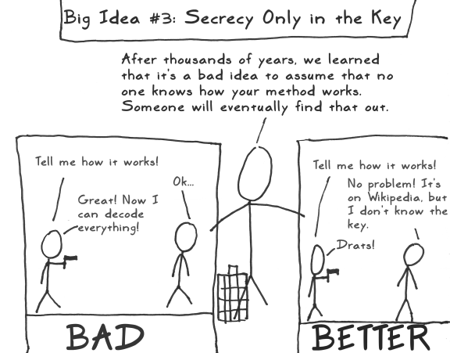
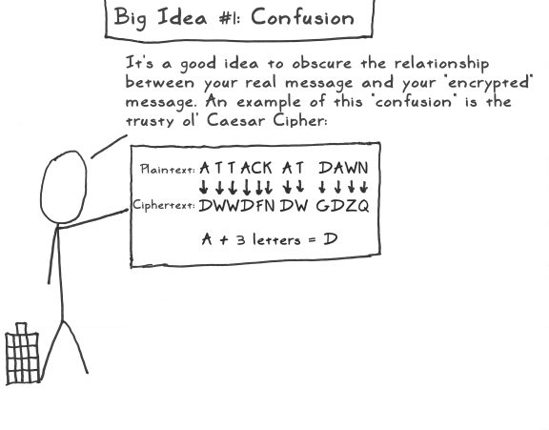
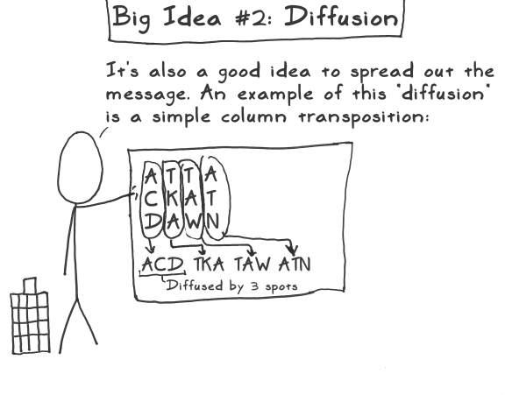
A less formal example…
http://www.moserware.com/2009/09/stick-figure-guide-to-advanced.html

Slide 6
What is the difference between Block and Stream Ciphers?
Block:
Block ciphers convert plain text into cipher text using a standardized block size. For example, a 128-bit block size would require the input plain text to be divisible by 128-bit blocks. If the plain text isn’t divisible by this value, then the plain test should be padded until it is divisible by the block size with no remainder.
Simply put, we break the plain text into segments that equal the block size so that we can encrypt entire blocks of plain text at a time.
Examples of Block Ciphers:
Speck Cipher (Created by the NSA)
Simon Cipher (Created by the NSA)
AES
Stream:
Stream ciphers convert plain text into cipher text one byte at a time. This means that no padding is required for this type of cipher. Stream ciphers tend to be simpler than block ciphers.
Examples of Stream Ciphers:
Salsa20 (Created by Daniel J. Bernstein)
Linear-Feedback Shift Register (LFSR)
SEAL

Slide 7
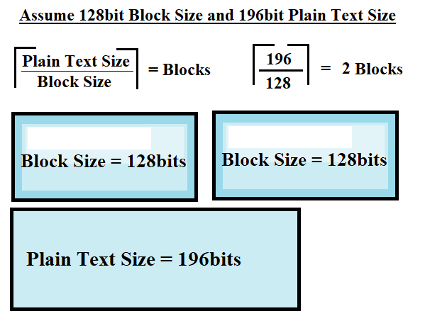
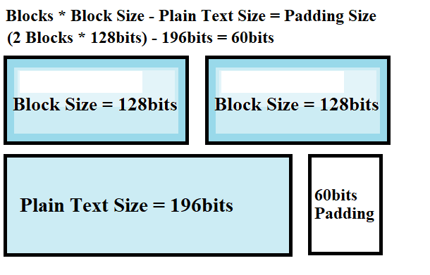
Example: How to calculate padding for Block Cipher plain text

Slide 8
A few words of caution: Padding is a naïve approach to resolve plain text size issues with block ciphers. A common flaw in padding is that with sufficiently small plain text messages, the encrypted output can quickly inflate in size. For example, assume our block cipher uses 64bit blocks and our message come in 32bit chunks. This would cause the output of our cipher to be twice the size of the initial message. Another common issue is that padding makes block cipher more vulnerable to tampering attacks. Other more complex solution exist that can avoid the downfalls of padding such as ciphertext steal or residual block termination (but that is a topic for another time ☺ ).

Slide 9
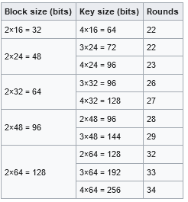
Speck Cipher (Block Cipher)
The Speck Cipher is a family of lightweight block ciphers created by the NSA and released to the public in 2013. The Speck Cipher has been optimized for software whereas its sister algorithm the Simon Cipher is optimized for hardware implementations. While I personally have experience implementing both algorithms, I will only go over the Speck Cipher today as the Simon Cipher requires in-depth knowledge on register transfer level (RTL) code such VHDL or Verilog to demonstrate properly.
The chart to the left shows what block, key, and round sizes
correspond to each other. For the example today I will be going over
the version with 128-bit block size, 128-bit key size, and 32 rounds.
https://en.wikipedia.org/wiki/Speck_(cipher)

Slide 10
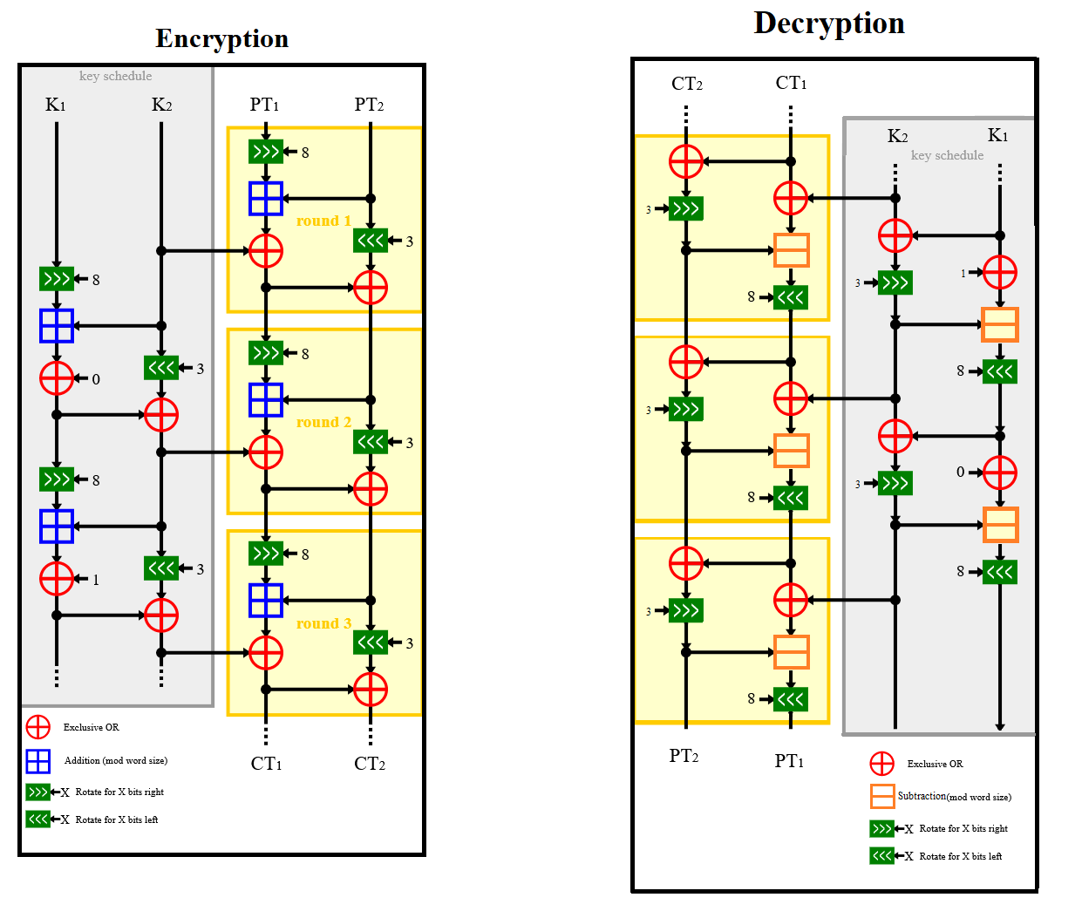
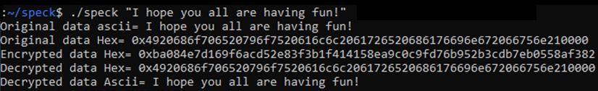
Speck Cipher Encryption and Decryption
For a working example in C++ with both encryption and decryption use the GitHub link below. Please note that this example uses padding which is generally bad practice for block ciphers.
https://github.com/caleb1000/speck_cipher

Slide 11
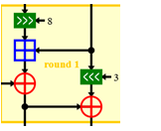
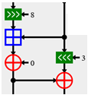
Bitwise operations:
Cipher Round
Key Rotation
Addition: Adds two unsigned values together and outputs the sum
Subtraction: Subtracts an unsigned value from another unsigned value and outputs the result
Example: Bitwise Rotate Right
Value = 4 (binary: 0100)
N = 3
Step 0 (binary value): Value = 0100
Step 1 (shift right 1): Value = 0010
Step 2 (shift right 1): Value = 0001
Step 3 (shift right 1): Value = 1000
Bitwise Rotate Right: Rotates an input value N number of bits to the right, looping the values shifted right to the front of the value.
(Note: this is different than simply shifting the number N times right)
Bitwise Rotate Left: Rotates an input value N number of bits to the left, looping the values shifted left to the end of the value.
(Note: this is different than simply shifting the number N times left)

Slide 12
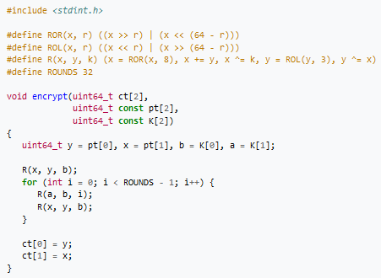
Speck Cipher Encryption
Cipher Round
Key Rotation
Below we have a function called encrypt that takes in a plain text block with a key which outputs the cipher text to the given array ct.
Notice we can use the same function for both cipher rounds and key rotations!
Rotate right
Rotate left
The number of Key Rotations is equal to the number of Cipher Rounds – 1. For this example, we have 32 Rounds so we will have 31 Key rotations!
Cipher round on plain text
Key rotation
Cipher round on plain text
Upper 64-bits of cipher text
Lower 64-bits of cipher text
https://en.wikipedia.org/wiki/Speck_(cipher)

Slide 13
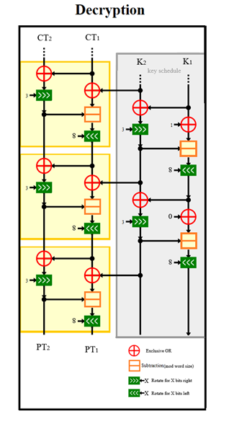
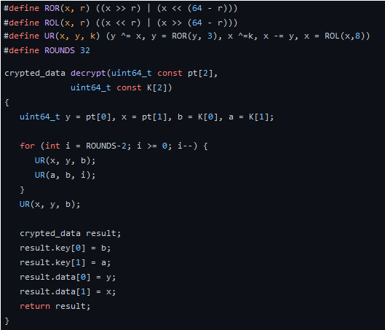
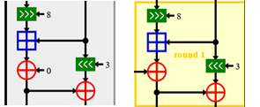
Speck Cipher Decryption
For decryption we must invert the functions we used to encrypt the data. For example, the inverse of doing an addition operation is subtraction. Interestingly, the inverse of XOR is itself.
Cipher Round
Key Rotation
Cipher Round
Key Rotation
Cipher Round
https://github.com/caleb1000/speck_cipher

Slide 14

LFSR [Linear-Feedback Shift Register] (Stream Cipher)
This cipher is known as a Synchronous Stream Cipher, meaning that to encrypt/decrypt the sender and receiver much transmit error free data that is in proper order. If the target bytes are out of order, then attempts to decrypt the message will fail.
Essentially, the current byte rely on the previous byte for the proper encryption/decryption. This means that even a small error (such as a single bit flip) can cause the remainder of the encrypted message to be indecipherable.
Can we get to an example please?…

Slide 15
LFSR Cipher Algorithm Pseudo Code
Using the following algorithm, we loop 8 times for each byte in the plain text (for example if the plain text is 4 bytes long, we will loop a total of 32 times). After every 8 loops we use the lowest byte of the state register S and XOR it with the current byte from the plain text. We continue this step until all bytes of the plain text have been encrypted.
Assume F is the value of the feedback, PT is the plain text, and S is the current value of the shift register, the next state of the cipher is calculated by the following steps:
for ( int x = 0 ; x<8 ; x++){
//for each byte of the plain text we need to loop through this 8 times (steps)
if ( 0x01 & S == 0){
//If the current shift register’s lowest bit is 0, simply shift the current shift register right one bit
S = S>>1;
}
else{
// If the current shift register’s lowest bit is 1 simply shift the current shift register right by one bit and XOR it with the value of F
S = (S>>1) ^ F
}
}
uint8_t encrypted_byte = (S & 0xFF) ^ PT[index]; // XOR the current plain text byte with the value gotten from the loop. Repeat for every byte in the plain text

Slide 16
Example: Encrypt First Byte
Assume F = 0xDEADBEEF and the initial value of S = 0x12345678
Assume plain text is “caci” (In Hex -> 0x63, 0x61, 0x63, 0x69)
Step 1
Initial S = 00010010001101000101011001111000
Because the lowest bit of S is zero, we shift S right by one bit
New S = 00001001000110100010101100111100
Step 5
Current S = 11011111100011101111101110001000
Because the lowest bit of S is zero, we shift S right by one bit
New S = 01101111110001110111110111000100
F = Feedback Register, PT =Plain Text, S = Shift Register
Step 2
Current S = 00001001000110100010101100111100
Because the lowest bit of S is zero, we shift S right by one bit
New S = 00000100100011010001010110011110
Step 6
Current S = 01101111110001110111110111000100
Because the lowest bit of S is zero, we shift S right by one bit
New S = 00110111111000111011111011100010
Step 3
Current S = 00000100100011010001010110011110
Because the lowest bit of S is zero, we shift S right by one bit
New S = 00000010010001101000101011001111
Step 7
Current S = 00110111111000111011111011100010
Because the lowest bit of S is zero, we shift S right by one bit
New S = 00011011111100011101111101110001
Step 4
Current S = 00000010010001101000101011001111
Because the lowest bit of S is one, we shift S right by one bit and XOR it with F
00000001001000110100010101100111 XOR 11011110101011011011111011101111
New S = 11011111100011101111101110001000
Step 8
Current S = 00011011111100011101111101110001
Because the lowest bit of S is one, we shift S right by one bit and XOR it with F
00001101111110001110111110111000 XOR 11011110101011011011111011101111
Final S = 11010011010101010101000101010111

Slide 17
Assume F = 0xDEADBEEF and the initial value of S = 0x12345678
Assume plain text is “caci” (In Hex -> 0x63, 0x61, 0x63, 0x69)
F = Feedback Register, PT =Plain Text, S = Shift Register
After eight steps we get the following S value
Final S = 11010011010101010101000101010111
Final S in Hex = 0xD3555157
Lowest S byte: S(0) = 0x57
Plain text = 0x63616369
First plain text byte: PT(0) = 0x63
S(0) XOR PT(0) = 0x34
The value 0x34 is the encrypted first byte of the cipher text message.
This whole process is repeated for every byte of the plain text, in this case it is going to be repeated 3 more times.
The final encrypted value of the cipher text is 0x349162F0

Slide 18
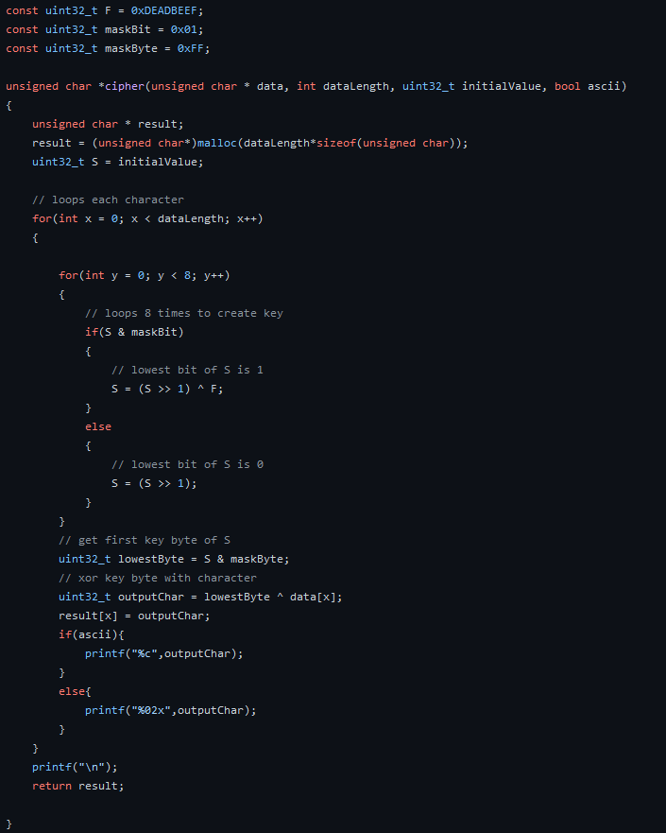
C++ Example of a Linear-Feedback Shift Register Algorithm
On the left is an example of a simple LFSR algorithm. Even with this meager amount of code we can encrypt and decrypt messages of any size. Because of this, Linear-Feedback Shift Registers are often used in ASICs (Application-Specific Integrated Circuit) where simplicity allows for cheaper hardware designs and lower circuit complexity. Furthermore, this cipher is the basis of many other stream ciphers.
Decryption for this algorithm is incredibly simple. Unlike block ciphers, we can simply use the same function for both encryption and decryption. By feeding the algorithm the cipher text and the same initial seed we can decrypt the plain text.
https://github.com/caleb1000/jpeg_secret_message/blob/main/cipher.cpp

Slide 19
Assume F = 0xDEADBEEF and the initial value of S = 0x12345678
Assume cipher text is 0x349162F0
Example: Decrypt First Byte
Step 1
Initial S = 00010010001101000101011001111000
Because the lowest bit of S is zero, we shift S right by one bit
New S = 00001001000110100010101100111100
Step 5
Current S = 11011111100011101111101110001000
Because the lowest bit of S is zero, we shift S right by one bit
New S = 01101111110001110111110111000100
F = Feedback Register, CT = Cipher Text, S = Shift Register
Step 2
Current S = 00001001000110100010101100111100
Because the lowest bit of S is zero, we shift S right by one bit
New S = 00000100100011010001010110011110
Step 6
Current S = 01101111110001110111110111000100
Because the lowest bit of S is zero, we shift S right by one bit
New S = 00110111111000111011111011100010
Step 3
Current S = 00000100100011010001010110011110
Because the lowest bit of S is zero, we shift S right by one bit
New S = 00000010010001101000101011001111
Step 7
Current S = 00110111111000111011111011100010
Because the lowest bit of S is zero, we shift S right by one bit
New S = 00011011111100011101111101110001
Step 4
Current S = 00000010010001101000101011001111
Because the lowest bit of S is one, we shift S right by one bit and XOR it with F
00000001001000110100010101100111 XOR 11011110101011011011111011101111
New S = 11011111100011101111101110001000
Step 8
Current S = 00011011111100011101111101110001
Because the lowest bit of S is one, we shift S right by one bit and XOR it with F
00001101111110001110111110111000 XOR 11011110101011011011111011101111
Final S = 11010011010101010101000101010111

Slide 20
Assume F = 0xDEADBEEF and the initial value of S = 0x12345678
Assume cipher text is 0x349162F0
F = Feedback Register, CT =Cipher Text, S = Shift Register
After eight steps we get the following S value
Final S = 11010011010101010101000101010111
Final S in Hex = 0xD3555157
Lowest S byte: S(0) = 0x57
Cipher text = 0x349162F0
First cipher text byte: CT(0) = 0x34
S(0) XOR CT(0) = 0x63
The value 0x63 is the decrypted first byte of the plain text message.
This whole process is repeated for every byte of the plain text, in this case it is going to be repeated 3 more times.
The final decrypted value of the plain text is 0x63616369
Which in ASCII is “caci”!

